Slide 1
The Dark Side of Meditation
Dr Christine Kupfer

Slide 2
What is meditation?
a wide “variety of practices that are intended to cultivate a particular state or quality of mind or body through the regulation or modulation of cognitive, affective, and perceptual faculties.” (www.oxfordbibliographies.com)
Goals/ orientation/ context
objects of meditation
types of attention; cognitive processes
roles of body
Deliberate work with energy?
Focus on God?
Even semantic ambiguity in the meaning of “mindfulness” –> implications on research on effects of meditation

Slide 3
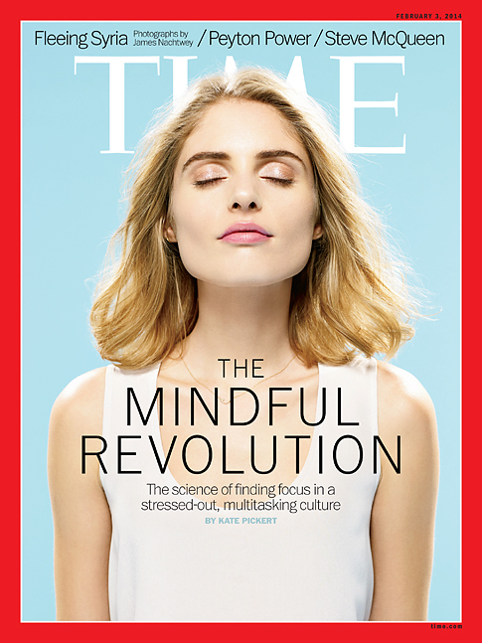

Slide 4
Panacea mindfulness
McMindfulness (Purser 2013)
Commercialization of mindfulness
MF as technique for any desired goal
Western project of perfecting the self, neoliberalism (MF as technology of the self)
Goal: increased productivity and compliance? Preserving status quo?
Antidote: Compassion, discernment & ethics (vs “mindful sniper”)
Mindfulness instead of therapy
Cheaper
No side-effects?

Slide 5
Research: Adverse effects of meditation
Few studies on adverse effects (“replication crisis”) (Kornfield 1979; Lomas et al. 2014; Shapiro 1992; VanderKooi 1997, Britton et al)
E.g. meditation-induced psychosis, retraumatization, depersonalization, strong negative emotions, involuntary movements, anomalous somatic sensations, out-of-body experiences, mania, changes in sense of self and reality of world, executive memory impairments, asociality, panic attacks, impaired reality testing, seizures, pain
Some acknowledgement by psychiatry (e.g. DSM-category of Religious and Spiritual Problems; Qi-gong psychotic reaction)

Slide 6
Meditation-related changes
Affective: fear/anxiety, Re-experiencing of traumatic memories/affect, depression/grief, positive affect…
Cognitive: delusional, irrational, or paranormal beliefs…
Social: social and/or occupational impairment; transition difficulties after retreat…
Perceptual: visual lights; hallucinations/visions…
Sense of self: change in boundaries self/other or self/world…
Conative: change in effort/striving; change in goal…
Somatic: somatic energy; sleep changes; pain…
Lindahl, Britton et al. (2017). The Varieties of Contemplative Experience.

Slide 7
Spiritual vs medical explanatory model Path vs adverse effects
Different interpretative frameworks:
adverse effect/ psychopathology vs religious/spiritual/mystical experience
Who decides/imposes?
Difficulties are interpreted as necessary stage of practice (need to be integrated to resolve)

Slide 8
Traditional frameworks: predicted difficulties
Most spiritual and religious texts say difficulties on path are expected (e.g., Buddhist stages-of-the-path literature; autobiographical reports of Dark Night of the Soul and kundalini awakenings
Lost in translation in secular mindfulness (Compson)?
makyō (Zen), nyams (Tibetan Buddhism): meditation experiences vs realizations, warnings about vipassanā-upakkilesā (“corruptions of insight”) that lead to false sense of spiritual progress that might result in misguided thinking and conduct
“Zen sickness”
Tibetan medicine: overmeditation or mental health problems like trauma → “srog-rLung” (problem of the wind) –> stop meditating
Paths that choose darkness
Processes of development: energies in subtle body; inner fire
Demons etc.

Slide 9
Spiritual bypassing & misinterpretations
Meditation as escape, to “feel good” and avoid darkness
“spiritual bypassing” (Welwood): "tendency to use spiritual ideas and practices to sidestep or avoid facing unresolved emotional issues, psychological wounds, and unfinished developmental tasks".
Misinterpretations
Spiritual path = turning away from darkness and “negative” emotions? → vs get intimate with & integrate darkness (shadow work)
Transcendence = ascension → vs. grounding & connection
Experiences of emptiness, bliss etc. as proof of spiritual advancement (pseudo-nirvana) → experiences are temporary; obstacle
Freedom from self (e.g, anatta, no-self): risk for depersonalization; risk for rationalizing fragile sense of self: “You have to be somebody before you can be nobody” (Engler)
non-attachment → risk for rationalizing inability to build stable relationships
Compassion, love, being open = weak boundaries, excessive tolerance → vulnerability

Slide 10
Decontextualization
…from physical context (monastic setting/ support)
…from everyday life (lack of integration can lead to alienation)
…from moral context (e.g., compassion, ethical guidelines)
…from ritual context (vs. just technique)
No initiation/ transmission→ possibly underprepared
Eliminating preparatory and protective rituals
“Patchwork spirituality” → lack of support through system & group
…from philosophical context
Making sense of experiences
Misunderstandings of concepts & of expected developments
conflict between interpretative frameworks

Slide 11
Contra-indicated methods?
Not much research. Practice specificity required.
mindfulness possibly safer than other forms BUT
surfacing of suppressed emotions and memories → retraumatization
Risk of increase of depression and of anxiety
Entry into other forms of meditation
High intensity meditation, retreats
Higher risk of psychosis, dpdr, and more
Retreat conditions might lead to problems
Certain more “dangerous” approaches (secret, faster, left-handed; tantric; breath control and of energy movement, kundalini awakening) → “break-in techniques” (Thomas)
Fit between meditation method and personality/problems of practitioner
Good timing?

Slide 12
People at risk
People in crisis are attracted to meditation
People without healthy self with good boundaries and good relationships (particularly personality disorder such as borderline, narcissim) → misinterpretations, DPDR, risk of exploitation…
Perfectionists/ overachievers with lack of self-compassion: pushing & striving
Persons with psychiatric or psychological problems (might need more support)
Addiction: avoid getting addicted to pleasant bodily/mental states
Severely traumatized: practice mindfulness first with mindful therapist (Treleaven 2018)
previous psychotic episodes (Shonin et al. 2014)
Depressed/suicidal: research differs whether suitable for those currently depressed. Can lead to increased suicidality (Kuyken, Crane, & Williams, 2012) and to higher awareness of low mood (Dobkin et al 2012)
Anxiety: can increase (Strauss et al 2014)
previous drug experiences
→ Preconditions, attitude, method & intensity are factors why meditation sometimes breaks into or break through resistance, defences, preconceptions, etc. prematurely or more forcefully than people are able to handle.

Slide 13
Remedies
Staying connected and grounded (physically, socially and mentally)
Awareness/mindfulness vs avoidance
Self-compassion
Ethics
Discernment, insight or wisdom
submitting to and trusting vs resisting (in process/ God/ kundalini…)
system to help interpret unusual experiences
Good teachers, supporting network (help to stabilize through appropriate methods, breaks and “antidotes”)
Sometimes medical or psychological treatment

Slide 14
Working with trauma
Hyperarausal
Can’t calm down
Fight or flight
Overwhelmed: Anxious, emotional distress, can’t think clearly
3 stages of recovery
Safety and stabilisation
Processing traumatic memories
Consolidation, integration and reconnection—resolution and recovery
Window of tolerance (Dan Siegel)
Trauma-sensitive mindfulness
Screening (e.g., Dobkin 2012)
Preparing the meditator
Facilitating stability and giving supports for staying grounded and out of distress (e.g. suitable anchor)
Creating collaborative relationships and creating safe environments by giving control to participants
Normalizing/ validating
Modelling and focusing on compassion for self and others
Referrals
Stress and trauma
decreases window
Therapeutic work
Increases window
Window of Tolerance
Engaged, alert
accessing reason & emotion
Optimal problem solving
Hypoarausal
Shutting down
No access to emotions, numb
Processing cannot take place

Slide 15
Left in the dark:
Psychosis & spiritual emergency
Abuse and exploitation related to meditation
Teachers
Qigong and kundalini
Spiritual forces and beings like demons
Comparison with other practices that can have similar effects (walking, art, the dark side of therapy, drugs)
Imagined trauma
Stealth Buddhism
And more

Slide 16
Embracing the Darkness

Slide 17
Roundtable
Dr Andrew Watson (Associate Medical Director for Psychiatry in Lothian; Snr Clinical Lecturer in Psychiatry at Uni of Edinburgh)
Dr Mark Miller (Philosopher of cognition)
Richard H H Johnston (Director of Christian Mindfulness)
Dr Audrey Millar (Consultant Clinical Psychologist)
Isaac Portilla (Researcher on the phenomenology of mystical experience, teacher of meditation)
Isabell Clarke (Consultant Clinical Psychologist & Spiritual Crisis Network Director)
Dr Liane Hofmann (Psychologist, researcher on spiritual and religious dimension into clinical psychotherapeutic practice)
Dr Christine Kupfer (Medical anthropologist, researcher on The Dark Side of Meditation)

